Slide 1

EC-6020
Embedded Systems Design
IoT-Enabled
Indoor Flood Entry Monitoring
Alerting System for Residential Safety
Presented by:
Group – 05

Slide 2
Contents
01
Introduction and Objectives
06
Design
02
07
Challenges faced
Problem Statement
Proposed Solution
03
08
Timeline
04
Proposed System Architecture
09
Deviations from Proposal and Revised Cost
05
Implementation steps
10
Accomplishments

Slide 3

Introduction & Objectives
Introduction
Our project focuses on developing an IoT-based system designed to detect indoor flood entries promptly. The primary goal is to provide real-time alerts to homeowners, enabling immediate action and minimizing potential damage.
Objectives
To detect indoor water entry at the earliest stage using a water level sensor.
To send immediate notifications to homeowners through mobile alerts and local buzzer alarms.
To minimize property damage and reduce electrical hazards caused by flooding.
To enable users to monitor flood conditions remotely using cloud connectivity.

Slide 4

Problem Statement
Addressing the critical need for proactive measures against indoor flooding.
Unexpected Flooding
Delayed Detection
Indoor floods occur without warning, often during heavy rain.
Current methods lack early detection, leading to significant delays.
Extensive Damage
Electrical Risks
Water can quickly ruin appliances, furniture, and structural elements.
Flooding poses severe risks of electrical shorts and electrocution.

Slide 5

Proposed Solution
Our system provides a multi-layered approach to ensure rapid flood detection and immediate notification.
Detect
Process
Transmit
Notify
Alarm
Water Level Sensor - Reliably detects the presence of water at critical points, initiating the alert sequence.
ATmega328 Microcontroller - Serves as the brain, processing sensor data and managing communication modules.
RF Module - Wireless communication device used to transmit securely and receive data using radio signals.
Web Application system -Delivers instant, real-time alerts to homeowners' smartphones, enabling swift action.

Slide 6
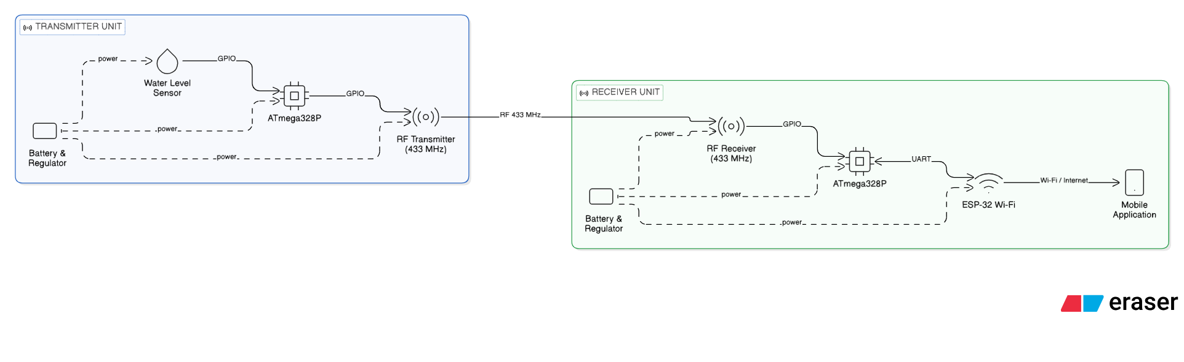
Proposed System Architecture
Our system leverages a robust architecture to ensure efficient flood detection and timely alerts, forming
a seamless chain from sensor to notification.

Slide 7

Implementation Steps
Selection of sensors, microcontrollers, and communication modules.
Hardware assembly and circuit setup for sensor and gateway nodes.
Programming of ATmega328 for sensor data processing and flood detection.
Calibration of water level and ultrasonic sensors for accurate measurement.
Integration of RF communication and ESP32 WiFi module for alert transmission.
System testing and debugging to ensure reliable flood detection and notification.

Slide 8
Design
Hardware Requirements
• Ultrasonic Sensor (HC-SR04)
• Water Level Sensor Module
• ATmega328 Microcontroller (2 units)
• RF Transmitter and Receiver Modules
• ESP-32 Wi-Fi Module (ESP8266)
• Buzzer
• LED
• Lithium iron Battery
• 16MHz Oscillator
• AMS 1117 Voltage regulator

Slide 9
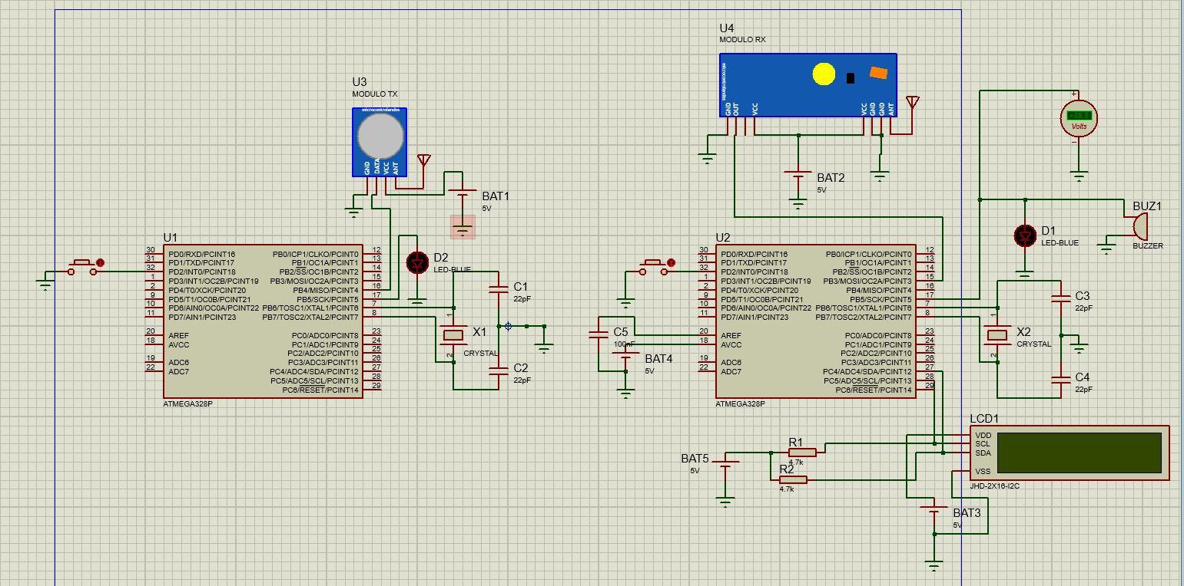
Design
Circuit Diagram

Slide 10
Challenges Faced
Sensor Calibration
WiFi Connectivity
Ensuring precise and reliable readings.
Maintaining stable wireless communication.
Power Stability
Component Availability
Ensuring continuous power for operation.
Sourcing hardware amidst market fluctuations.
Budget Limitations
Managing costs effectively without compromise.

Slide 11
Timeline
Our project follows a structured timeline, ensuring a systematic and efficient development process from
conceptualization to final adjustments.
Week 1–2
1
Research and requirement analysis
2
Week 3–4
Component Selection
Week 5–6
3
System architecture design and planning
Circuit design and component procurement
4
Week 7–8
Hardware assembly and initial firmware development
Sensor integration and communication protocol implementation
Week 9–10
5
IoT integration and cloud communication setup
Web application development
6
Week 11–12
Web system and hardware integration
Week 13–14
7
System testing and user interface refinement
Final integration, documentation, and project submission

Slide 12
Accomplishments
Developed and finalized the software logic for flood detection, alert transmission, and data validation.
Implemented reliable RF communication between the sensor node and gateway node for wireless alert transmission.
Conducted system-level testing under simulated indoor flooding conditions and verified successful alert delivery.
We have completed the full hardware prototype of the indoor flood monitoring system.
Configured the ESP32 Wi-Fi module to send real-time flood notifications to the mobile application.

Slide 13
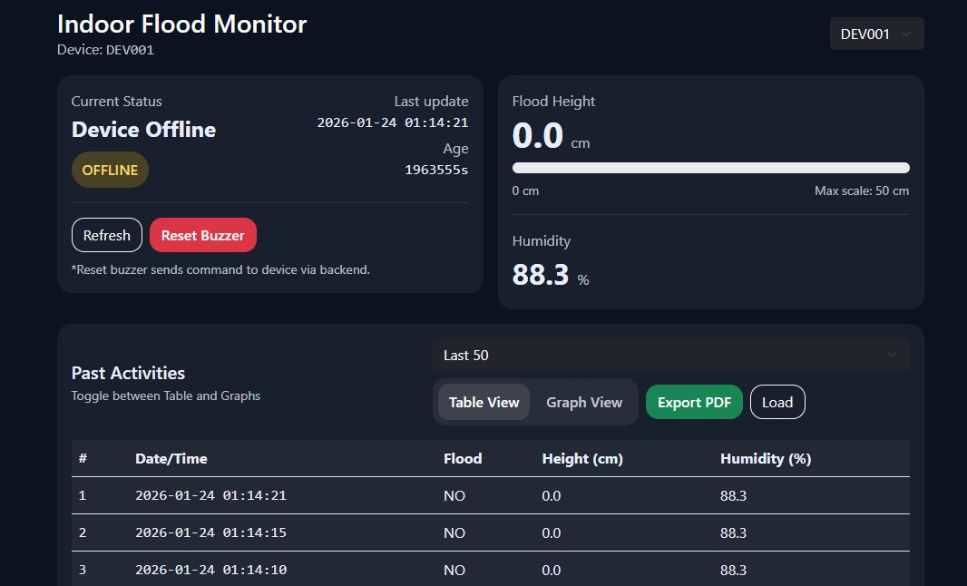
Accomplishments
UI Layout

Slide 14

Thank You
Group – 05 :
2022/E/102 DANGSHAN N.
2022/E/104 KISOTHANA P.
2021/E/117 JAMES P.S.V.
2021/E/148 THILOOKSHAN S.
2021/E/192 AJANTHAN T.
2018/E/107 SARUGESH R.

